Slide 1

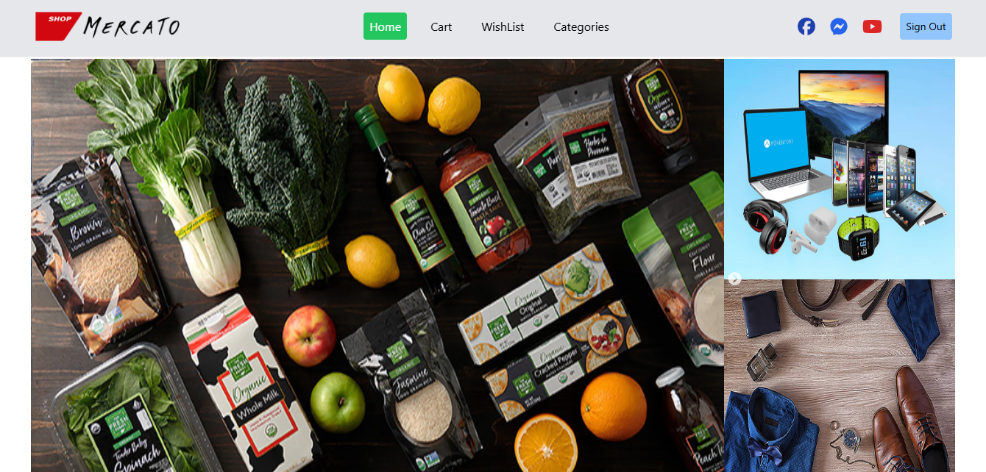

E-commerce Platform
Project Overview and Team Roles

Slide 2
Table of contents
1
4
2
5
3
6
Project Overview
Technology Stack
Brief introduction and purpose of Mercato.
Tools and technologies used to build Mercato.
Vision and Mission
Team Roles
The long-term goal and the guiding principles behind the project.
The roles and contributions of team members.
Key Features
Future Enhancements
Highlight of the platform's main functionalities.
Planned upgrades and new features for Merkato.

Slide 3
Project Overview
Mercato is an e-commerce platform designed to facilitate smooth and efficient online shopping. It enables users to browse products, add items to their shopping carts, make secure payments, and track their orders.

Slide 4
Purpose: Target Audience:
Provide an intuitive shopping experience for customers
Empower sellers to list and manage their products
Ensure secure transactions and timely delivery
Shoppers: Individuals looking for a reliable and user-friendly platform to purchase products online.
Sellers: Small to medium businesses looking for an easy way to sell products

Slide 5
Vision and Mission
Vision:
Mission:
To become a leading e-commerce platform that bridges the gap between sellers and buyers, providing a seamless online shopping experience.
Build a user-friendly platform that allows customers to browse, shop, and check out effortlessly.
Provide sellers with tools to manage inventory, sales, and customer interactions.
Ensure a secure and scalable architecture that supports growth.

Slide 6

Key Features
Product Browsing:
Shopping Cart:
Easy-to-navigate product categories and filtering options, allowing users to quickly find what they need.
Real-time updates and a smooth checkout flow with clear pricing and delivery details.
User Authentication:
Payment Integration:
Secure registration and login processes with data encryption.
Secure payment gateways with support for credit cards, PayPal, and more.

Slide 7
Technology Stack

Slide 8
React.js: Component-based architecture for a responsive and dynamic user interface.
Tailwind CSS: Utility-first CSS framework for styling, ensuring a clean and responsive design.

Slide 9
Version Control:
Git and GitHub: For managing source code, tracking changes, and collaborating with any team members.

Slide 10
Team Roles
Mina Ashraf Abdallah
Frontend Developer, Project Lead
Contributions:
Homepage: Developed the homepage layout, including the hero section, featured products, and categories, ensuring a smooth user experience.
Product Pages: Created product detail pages with dynamic content such as product descriptions, images, pricing, and reviews.
Checkout Flow: Designed and implemented the checkout process, allowing users to review their carts, enter shipping information, and complete transactions securely.

Slide 11
Hassan Mohsen
Frontend Developer
Contributions:
Registration Page: Developed the user registration page, including input validation and error handling to ensure a smooth signup experience.
Login Page: Created the login functionality, implementing secure authentication methods and managing user sessions.

Slide 12
Future Enhancements
Multi-language Support:
Expand the platform to support multiple languages for international users.
Additional Payment Methods:
Integrate more payment gateways to accommodate a wider range of customers.
AI-based Recommendations:
Implement a recommendation engine that suggests products based on user behavior and preferences.

